Slide 1
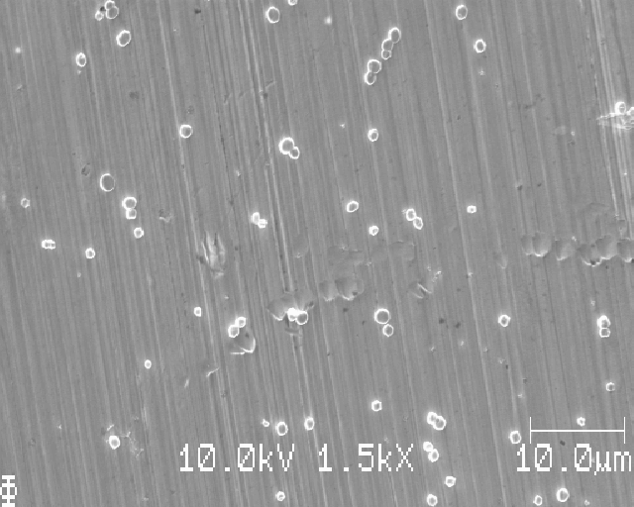
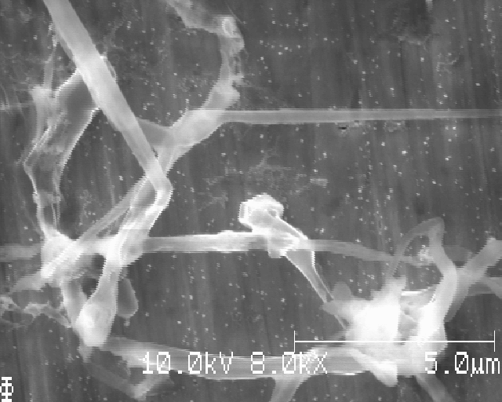
Progress update on master’s thesis about nucleation of lithium
Gottfrid Olsson
2024-03-22

Slide 2
Purpose of this work
’’How does the
a) substrate,
b) current density, and
c) deposited areal capacity (mAh/cm²)
affect the Li-nuclei size distribution?’’

Slide 3
Experimental process, step by step
Prepare materials
Assemble cell
Cycle
Disassemble cell and wash electrode
Measure in SEM
Data analysis of SEM-images

Slide 4
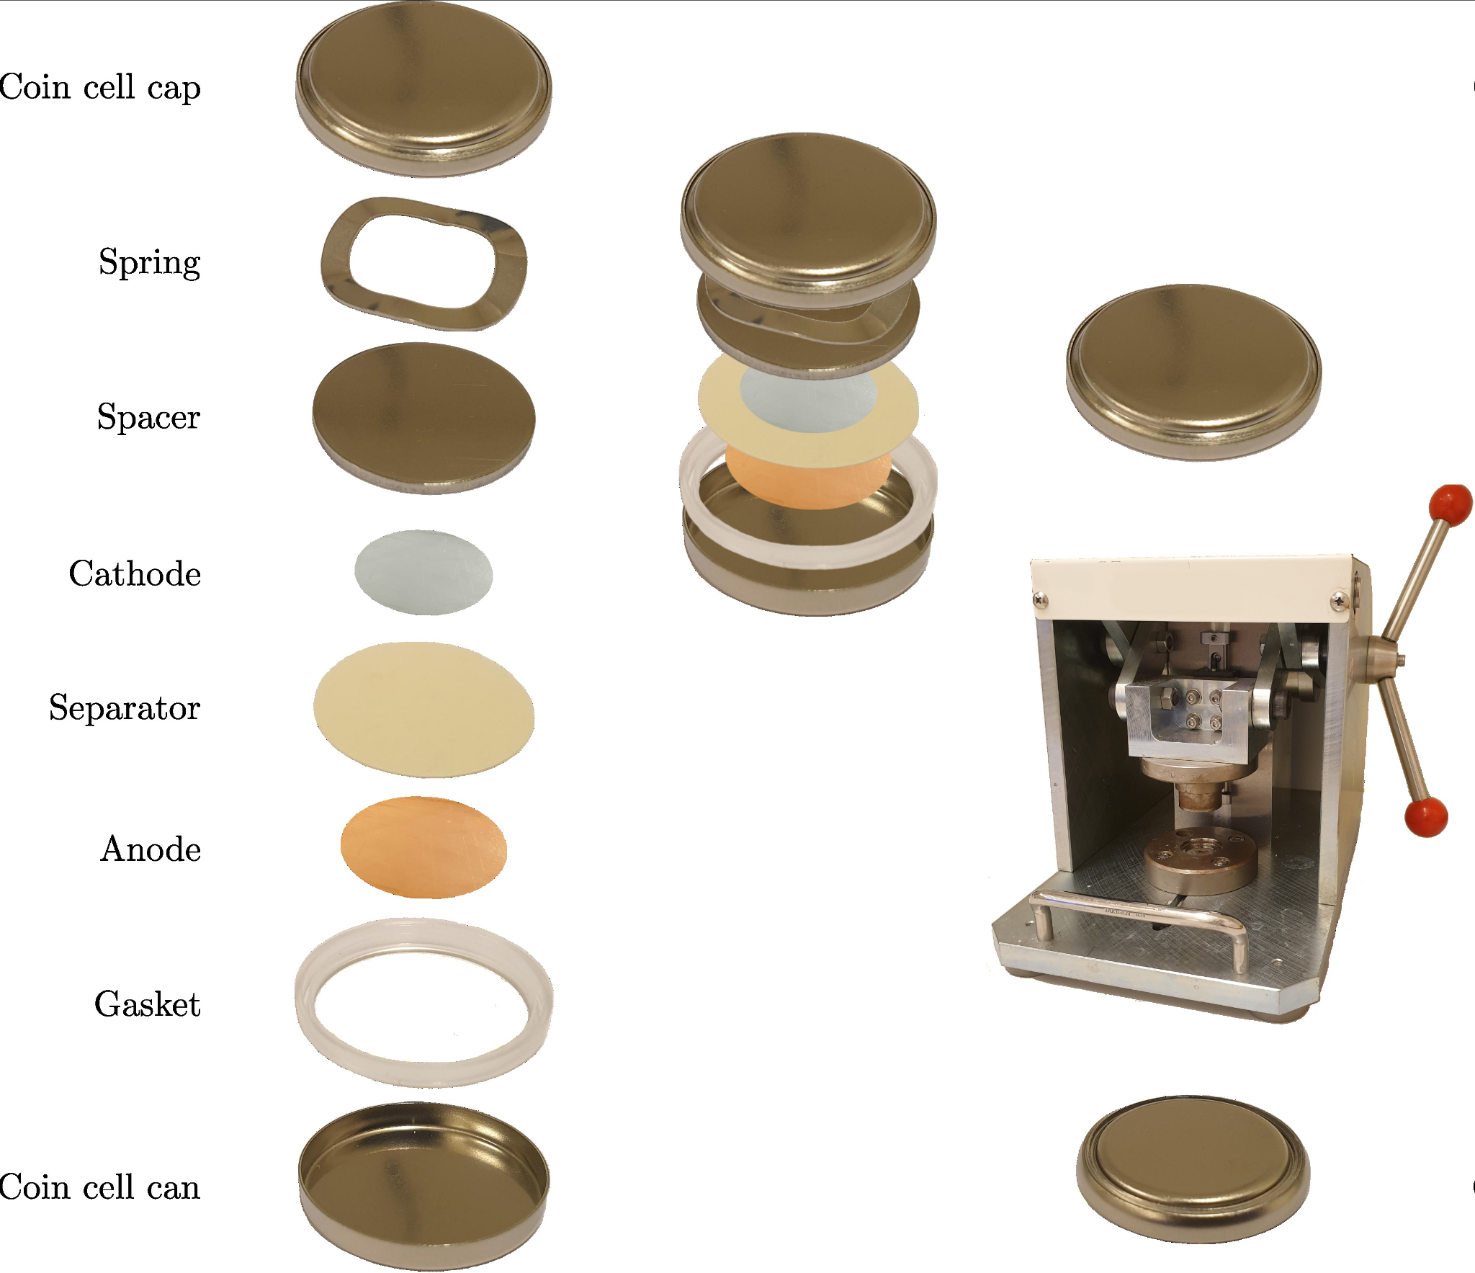
First: coin cells
Li
Cu

Slide 5
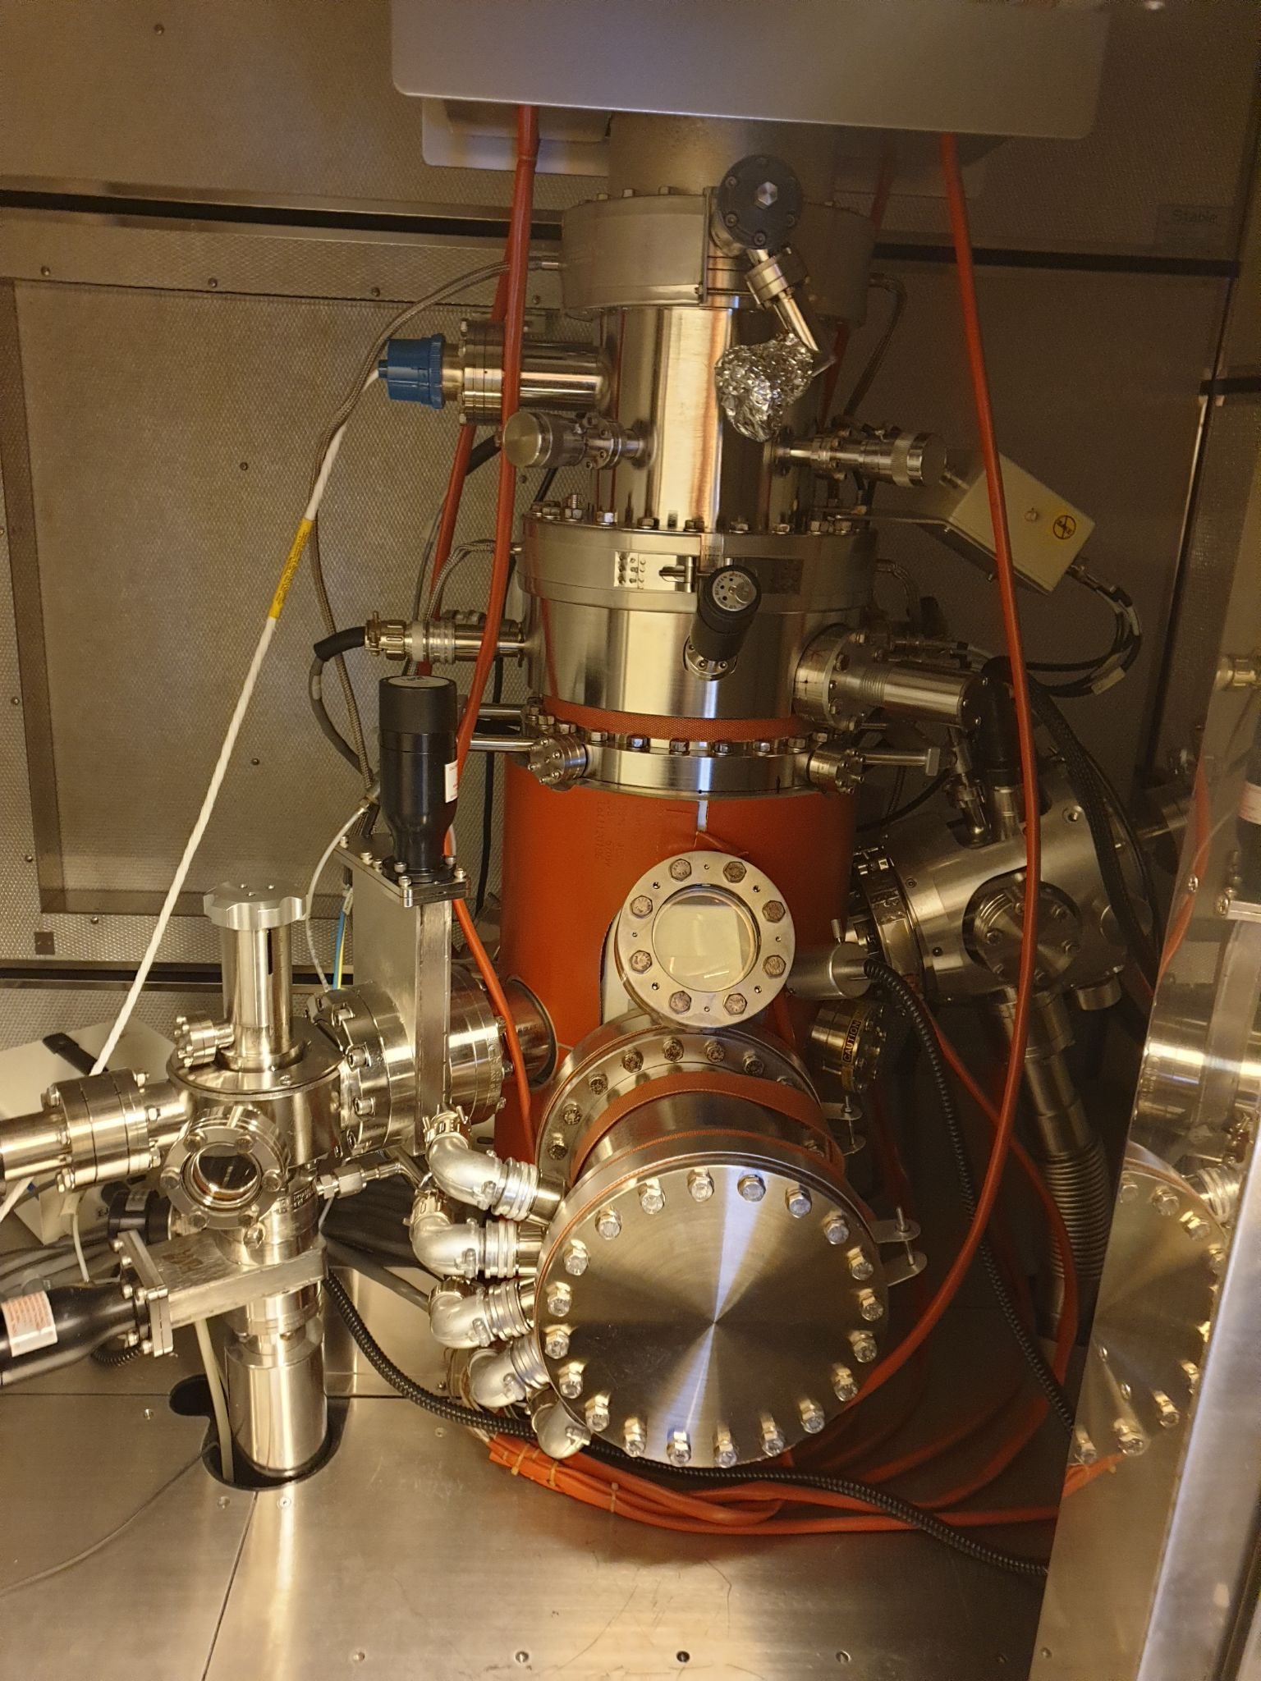
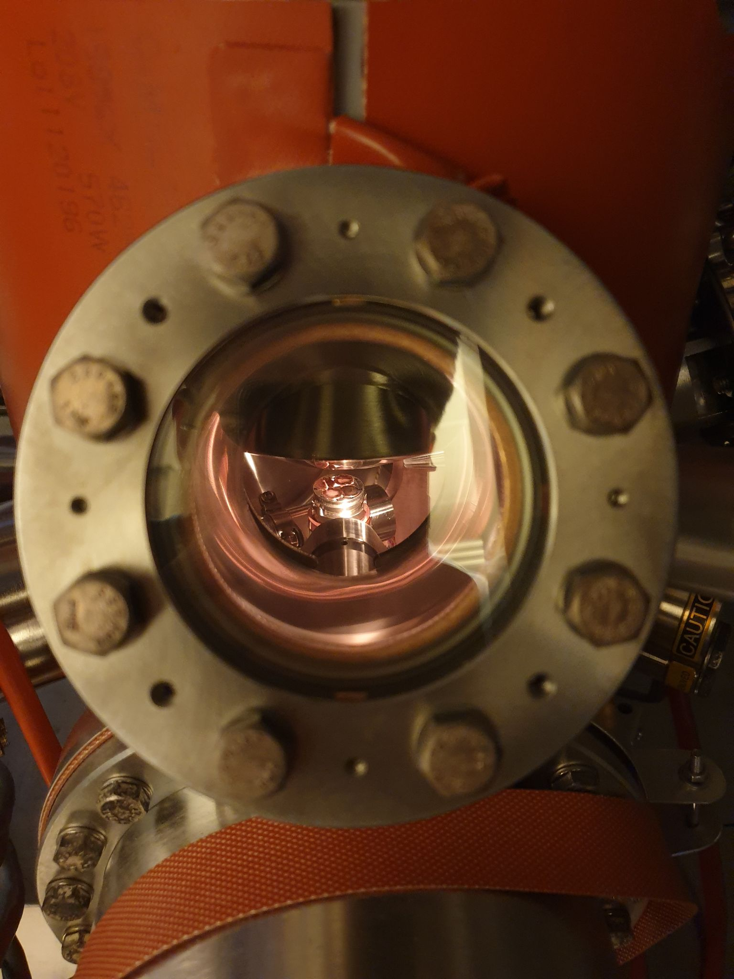
Sample in SEM

Slide 6
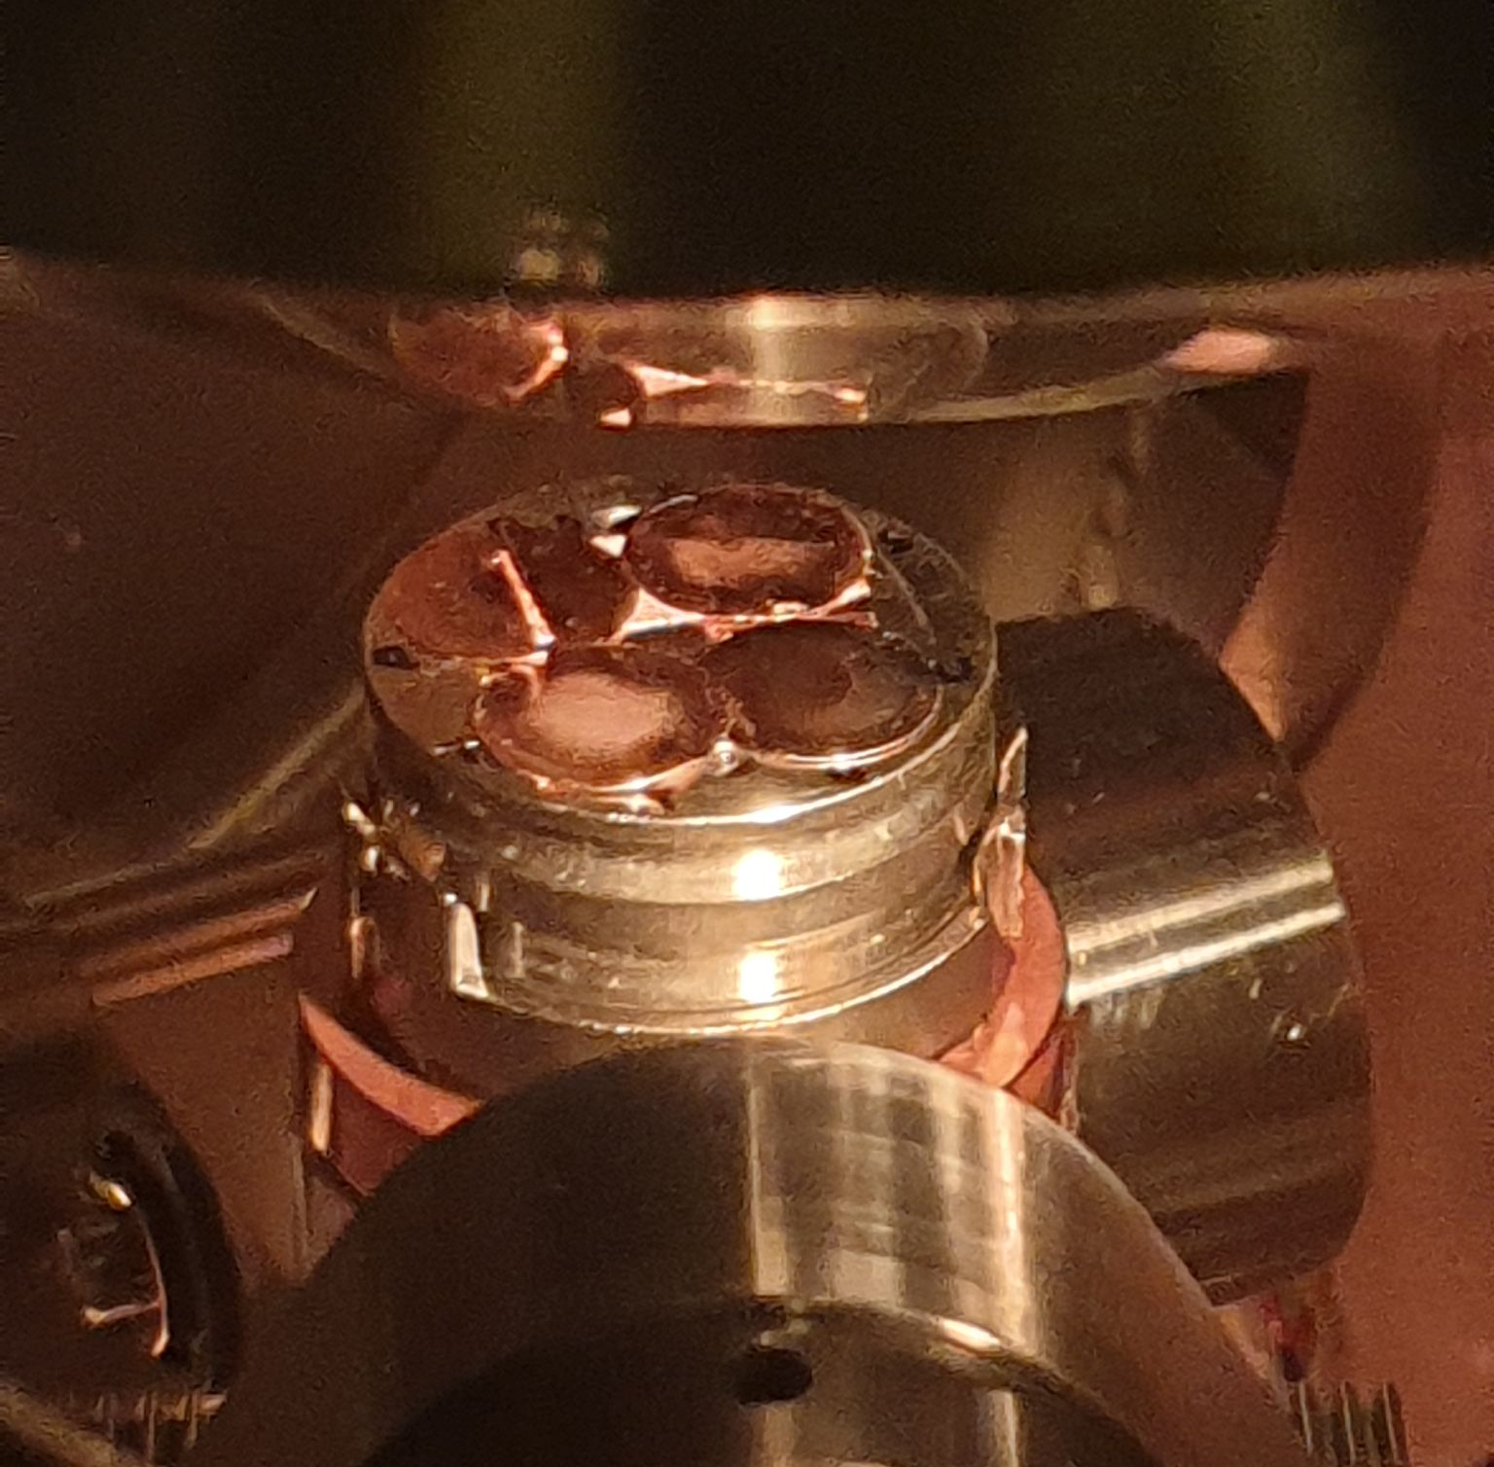
Sample in SEM

Slide 7
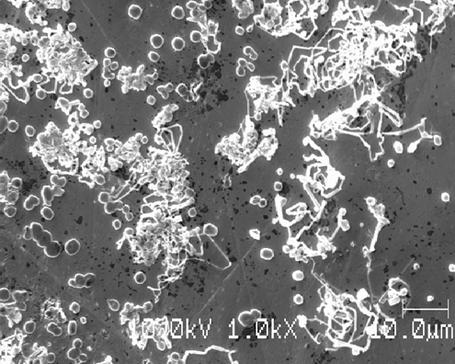
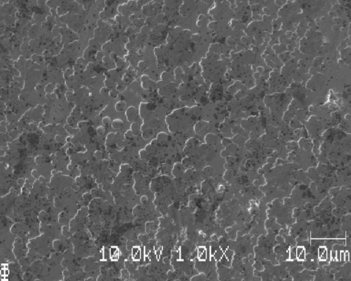
SEM-images
0.050 mAh/cm², morphologies: spherical nuclei, spaghetti, flat islands
Notes:
SEI-formation: s ̊ag nukleering av Li, olika sorters morfologier (mindre ’runda’ kristalliska
partiklar, l ̈angre spaghetti, plattare ̈oar). H ̈og densitet av Li i en ring, l ̊ag densitet i mitten.
SEI-formationen verkar inte spela stor roll, vi v ̈aljer d ̈arf ̈or den enklaste och snabbaste. Vi
s ̊ag dessutom att SEI-formation utan deposition inte gav n ̊agon Li-deposition, bra kontroll

Slide 8
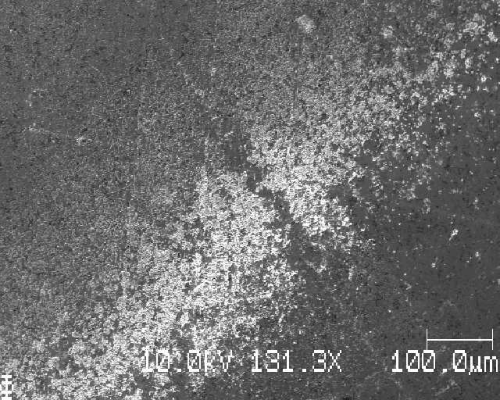
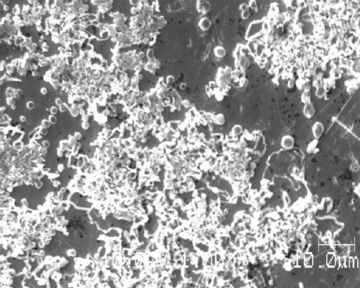
SEM-images
Uneven deposition: more at edge of Li-metal, here mostly spaghetti
Notes:
SEI-formation: s ̊ag nukleering av Li, olika sorters morfologier (mindre ’runda’ kristalliska
partiklar, l ̈angre spaghetti, plattare ̈oar). H ̈og densitet av Li i en ring, l ̊ag densitet i mitten.
SEI-formationen verkar inte spela stor roll, vi v ̈aljer d ̈arf ̈or den enklaste och snabbaste. Vi
s ̊ag dessutom att SEI-formation utan deposition inte gav n ̊agon Li-deposition, bra kontroll

Slide 9
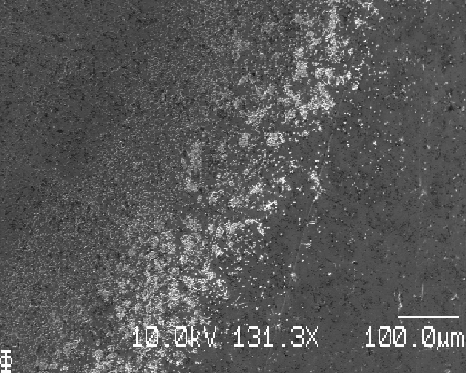
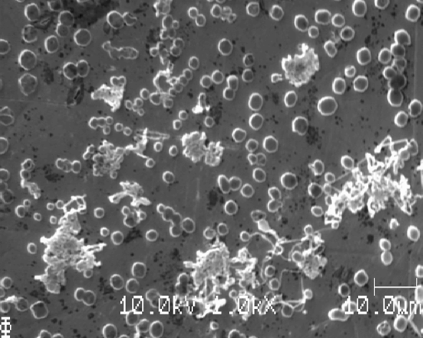
SEM-images
Uneven deposition: more at edge of Li-metal, here less spaghetti
Notes:
SEI-formation: s ̊ag nukleering av Li, olika sorters morfologier (mindre ’runda’ kristalliska
partiklar, l ̈angre spaghetti, plattare ̈oar). H ̈og densitet av Li i en ring, l ̊ag densitet i mitten.
SEI-formationen verkar inte spela stor roll, vi v ̈aljer d ̈arf ̈or den enklaste och snabbaste. Vi
s ̊ag dessutom att SEI-formation utan deposition inte gav n ̊agon Li-deposition, bra kontroll

Slide 10
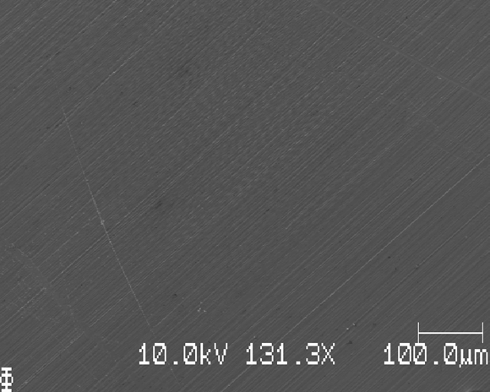
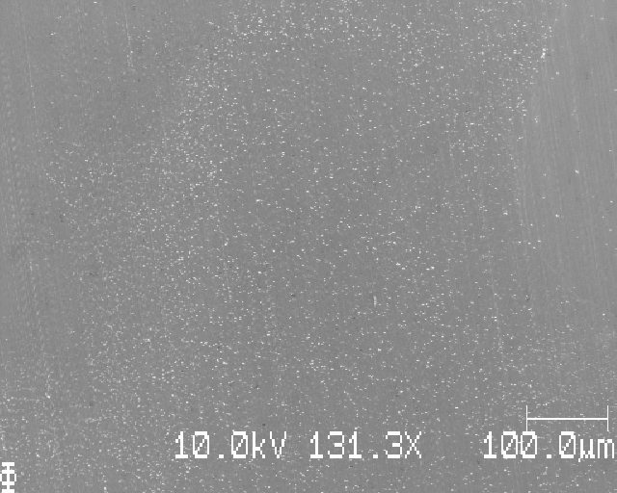
SEM-images
0.005 mAh/cm² (left) and 0.010 mAh/cm² (right)
Notes:
Fler CA / mAh cm−2: inga tecken p ̊a Li f ̈or 0,005; Li-k ̈arnor runt 1 mikrometer i diameter
f ̈or 0,010 (s ̊ag lovande ut!), men deposition f ̈oljde ring (knappcell); nukleering och tillv ̈axt
f ̈or 0,025 (f ̈or mycket). Noterade ’halo’ kring d ̈od(?) Li f ̈or 0,025. Tryckberoende form f ̈or
Li f ̈or 0,025, se slides 32, 33 och 34

Slide 11
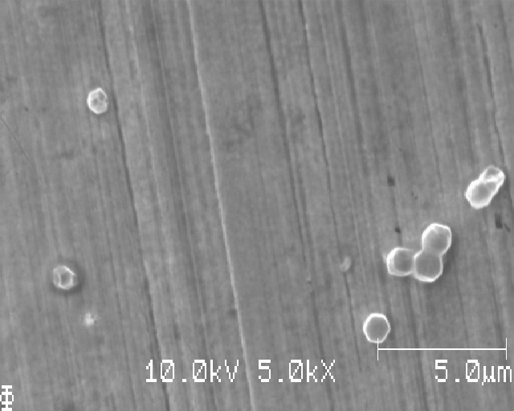
SEM-images
0.010 mAh/cm², Li-particle around 1 μm

Slide 12
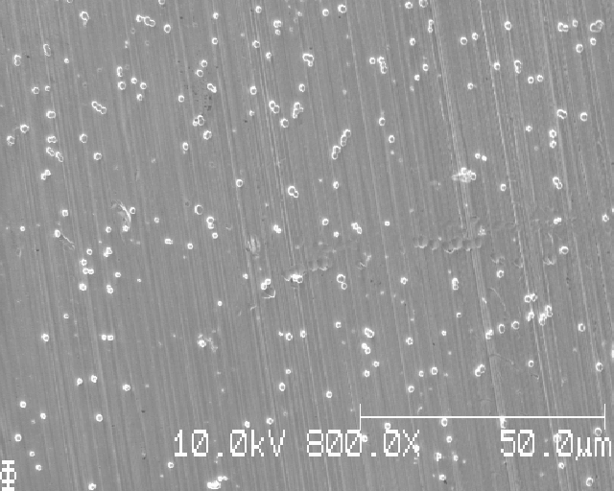
SEM-images
0.010 mAh/cm², promising images for analysis

Slide 13
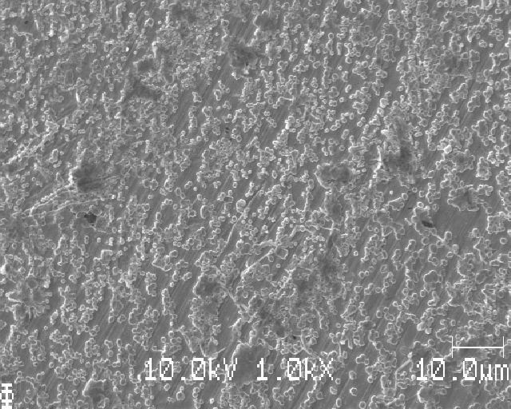
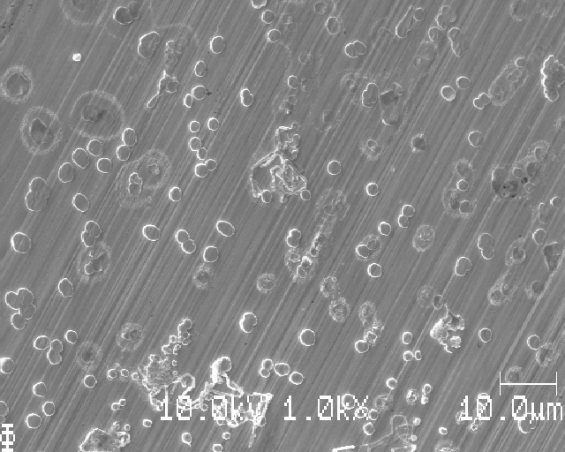
SEM-images
0.025 mAh/cm² (left: much deposition, right: another place, halos)
Notes:
Fler CA / mAh cm−2: inga tecken p ̊a Li f ̈or 0,005; Li-k ̈arnor runt 1 mikrometer i diameter
f ̈or 0,010 (s ̊ag lovande ut!), men deposition f ̈oljde ring (knappcell); nukleering och tillv ̈axt
f ̈or 0,025 (f ̈or mycket). Noterade ’halo’ kring d ̈od(?) Li f ̈or 0,025. Tryckberoende form f ̈or
Li f ̈or 0,025, se slides 32, 33 och 34

Slide 14
SEM-images
0.025 mAh/cm², pressure dependent Li-morphology (next slide)
Notes:
Fler CA / mAh cm−2: inga tecken p ̊a Li f ̈or 0,005; Li-k ̈arnor runt 1 mikrometer i diameter
f ̈or 0,010 (s ̊ag lovande ut!), men deposition f ̈oljde ring (knappcell); nukleering och tillv ̈axt
f ̈or 0,025 (f ̈or mycket). Noterade ’halo’ kring d ̈od(?) Li f ̈or 0,025. Tryckberoende form f ̈or
Li f ̈or 0,025, se slides 32, 33 och 34

Slide 15
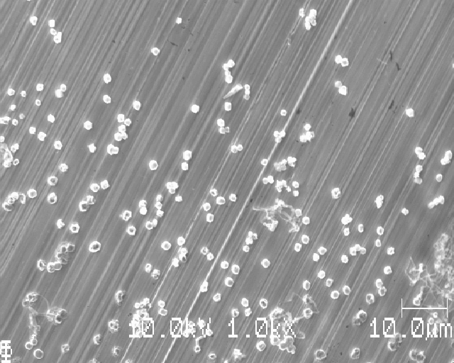
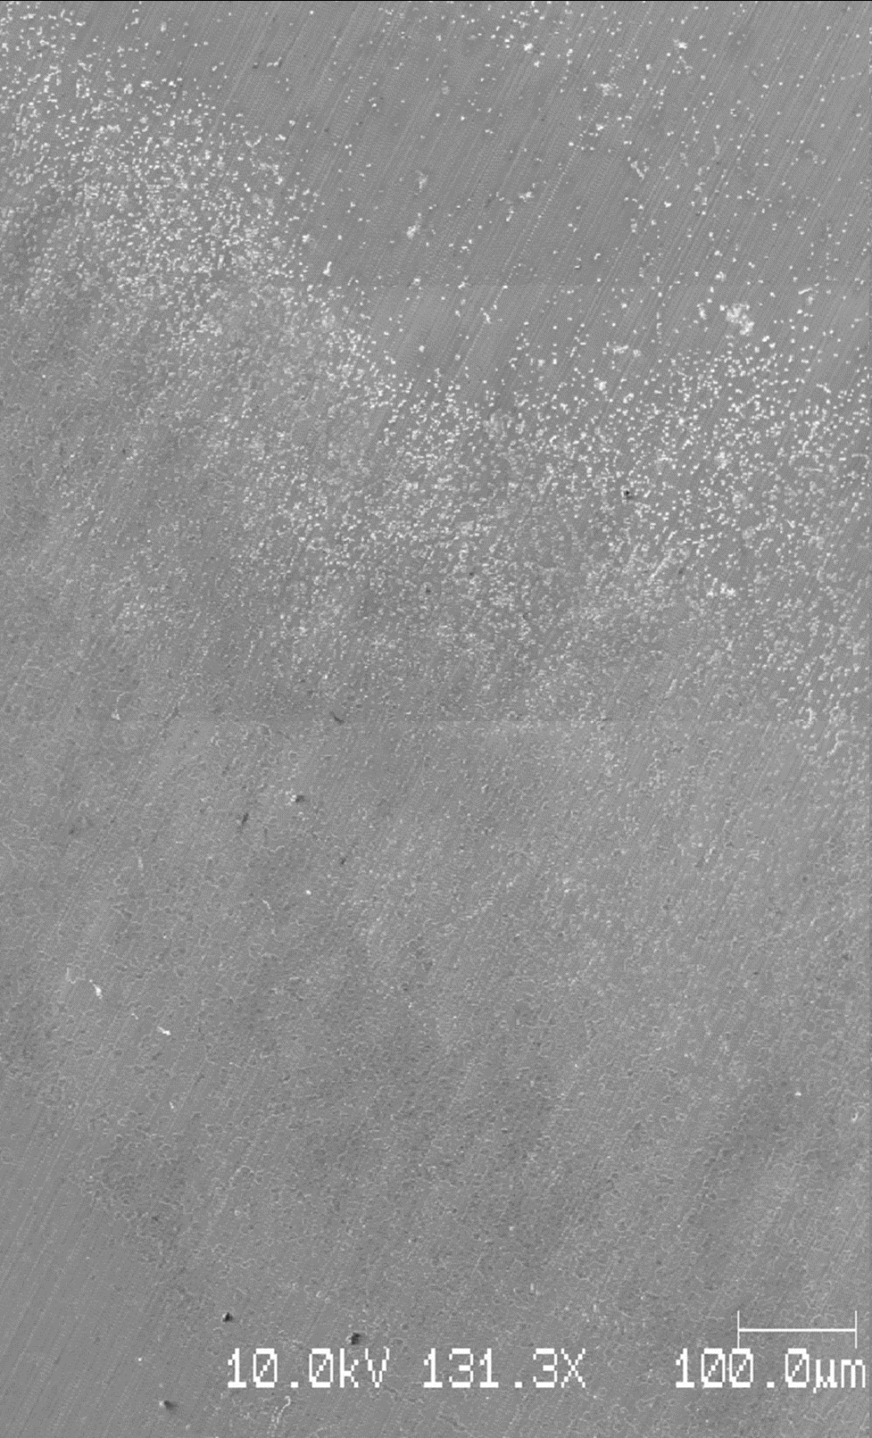
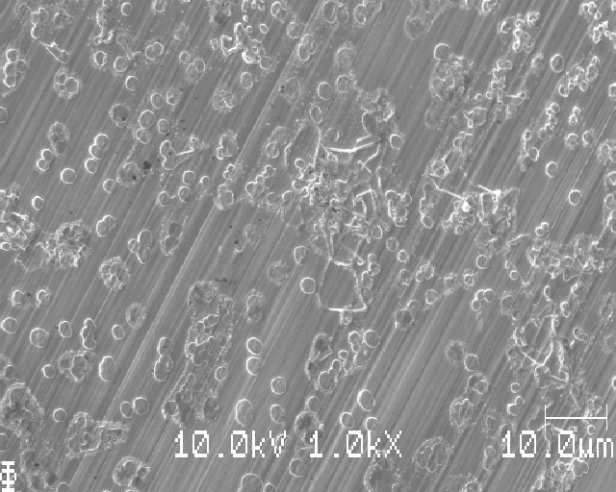
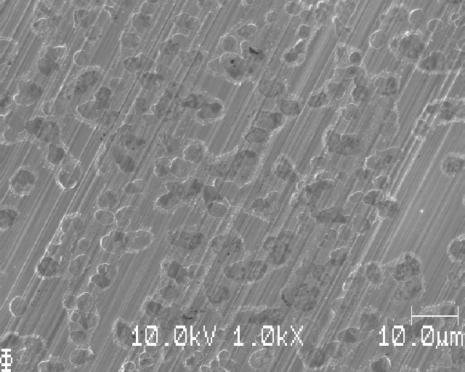
Notes:
tryckberoende form, slides 32, 33, 34

Slide 16
What we learned
No obvious difference for different SEI-formation protocols
Several different Li-morphologies
Uneven Li-deposition – appears to be pressure-dependent
Nucleation and growth for ≥ 0.025 mAh/cm²
Notes:
SEI-formation: s ̊ag nukleering av Li, olika sorters morfologier (mindre ’runda’ kristalliska
partiklar, l ̈angre spaghetti, plattare ̈oar). H ̈og densitet av Li i en ring, l ̊ag densitet i mitten.
SEI-formationen verkar inte spela stor roll, vi v ̈aljer d ̈arf ̈or den enklaste och snabbaste. Vi
s ̊ag dessutom att SEI-formation utan deposition inte gav n ̊agon Li-deposition, bra kontroll

Slide 17
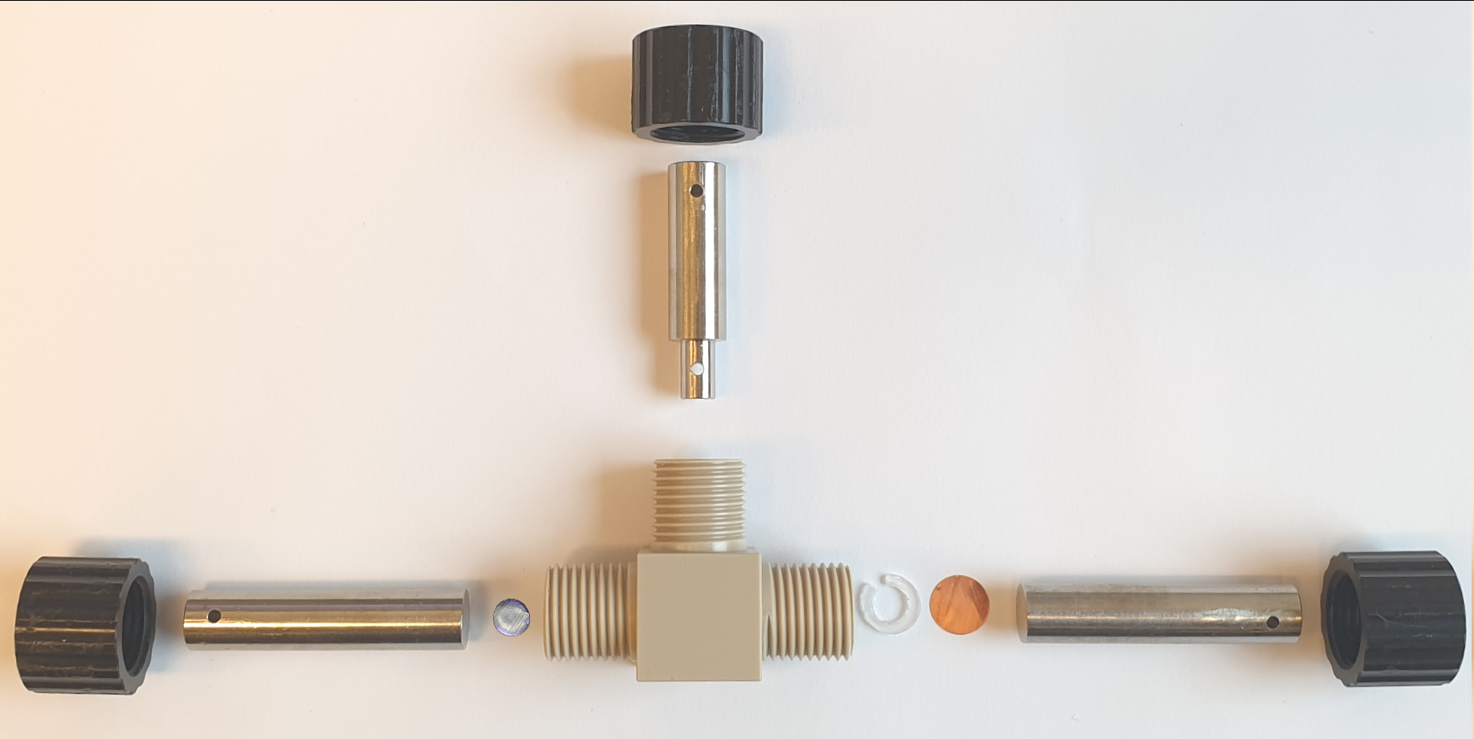
No pressure! (T-cells from here on)

Slide 18
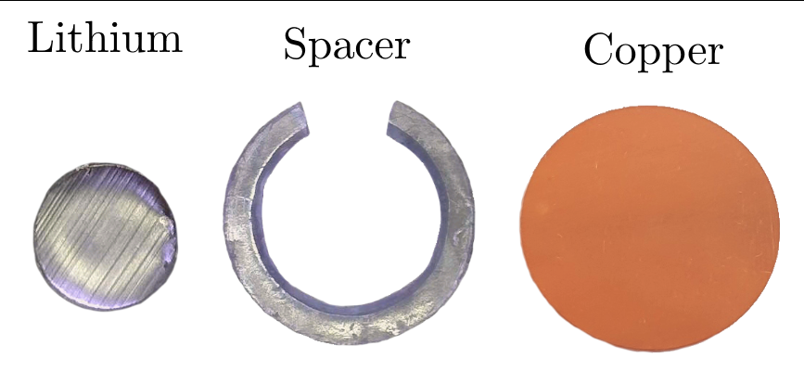
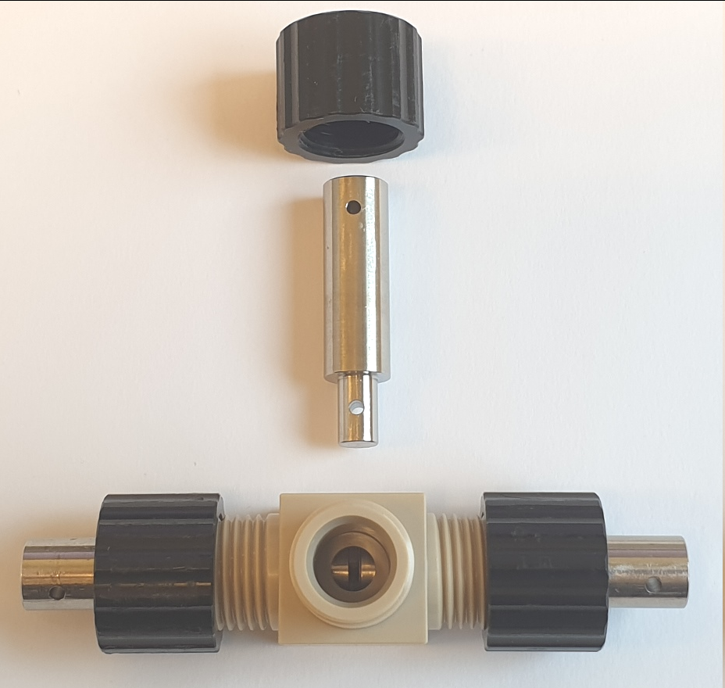
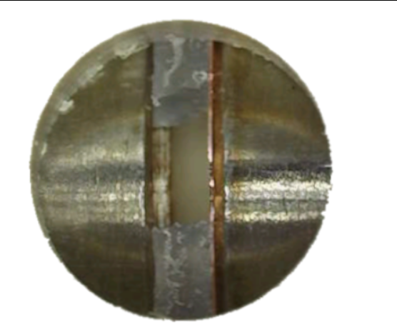
No pressure! (T-cells from here on)

Slide 19
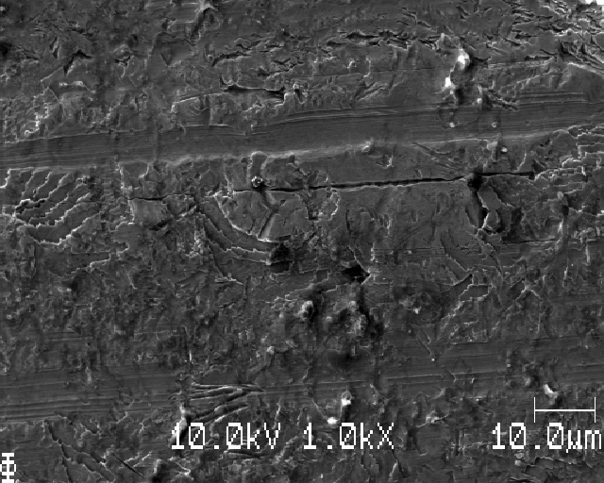
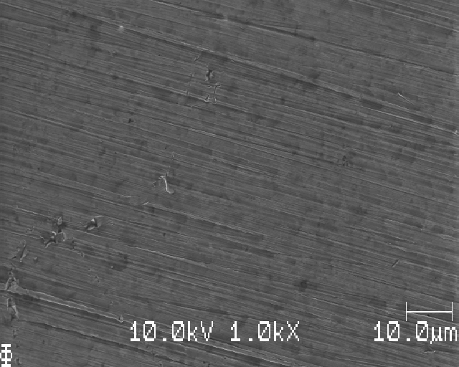
SEM-images
Unpolished (left) vs. polished (right)
Notes:
Olika CA f ̈or T-cell: s ̊ag hur ett prov ser ut opolerat (r ̊akade v ̈anda den), polering kr ̈avs!
S ̊ag f ̈or 0,050 att det var nukleering och mycket tillv ̈axt, f ̈or 0,025 var det snarare nukleering
̈an tillv ̈axt men en del skr ̈ap gjorde det sv ̊art att s ̈aga, f ̈or 0,010 var det i princip inget Li
(f ̈orutom ’The Lonely Li’). OBS! Dessa prover blev lite strul under cellmontering, varf ̈or
m ̈angden Li p ̊a de inte b ̈or tas som r ̈attvis sanning. Mer homogen Li-deposition i T-cell
(tryckfri) j ̈amf ̈ort med knappcell. Tv ̈atten var oregelbunden f ̈or dessa prover

Slide 20
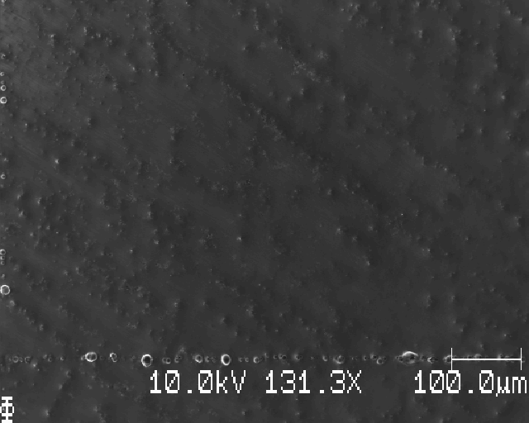
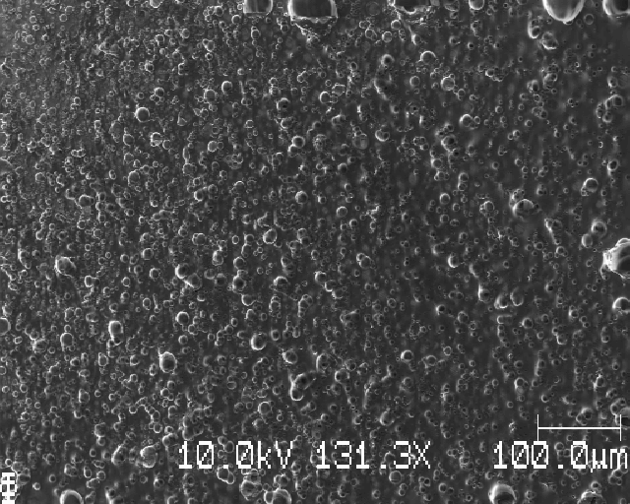
SEM-images
Dirt/salt looks like this, same place a short time apart
Notes:
Olika CA f ̈or T-cell: s ̊ag hur ett prov ser ut opolerat (r ̊akade v ̈anda den), polering kr ̈avs!
S ̊ag f ̈or 0,050 att det var nukleering och mycket tillv ̈axt, f ̈or 0,025 var det snarare nukleering
̈an tillv ̈axt men en del skr ̈ap gjorde det sv ̊art att s ̈aga, f ̈or 0,010 var det i princip inget Li
(f ̈orutom ’The Lonely Li’). OBS! Dessa prover blev lite strul under cellmontering, varf ̈or
m ̈angden Li p ̊a de inte b ̈or tas som r ̈attvis sanning. Mer homogen Li-deposition i T-cell
(tryckfri) j ̈amf ̈ort med knappcell. Tv ̈atten var oregelbunden f ̈or dessa prover

Slide 21
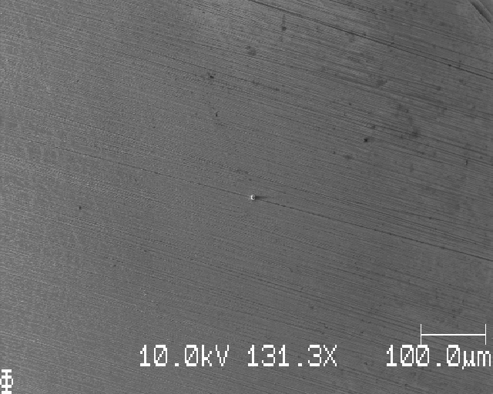
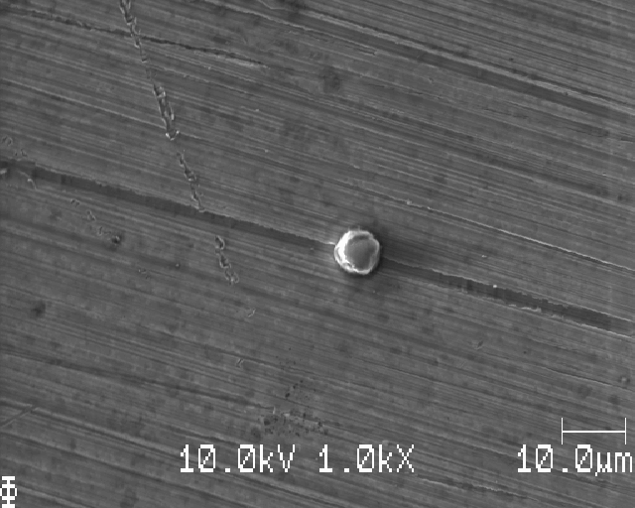
SEM-images
The Lonely Li
Notes:
0.010 mAh/cm2; but troubles during assembly and cycling means unreliable results
Olika CA f ̈or T-cell: s ̊ag hur ett prov ser ut opolerat (r ̊akade v ̈anda den), polering kr ̈avs!
S ̊ag f ̈or 0,050 att det var nukleering och mycket tillv ̈axt, f ̈or 0,025 var det snarare nukleering
̈an tillv ̈axt men en del skr ̈ap gjorde det sv ̊art att s ̈aga, f ̈or 0,010 var det i princip inget Li
(f ̈orutom ’The Lonely Li’). OBS! Dessa prover blev lite strul under cellmontering, varf ̈or
m ̈angden Li p ̊a de inte b ̈or tas som r ̈attvis sanning. Mer homogen Li-deposition i T-cell
(tryckfri) j ̈amf ̈ort med knappcell. Tv ̈atten var oregelbunden f ̈or dessa prover

Slide 22
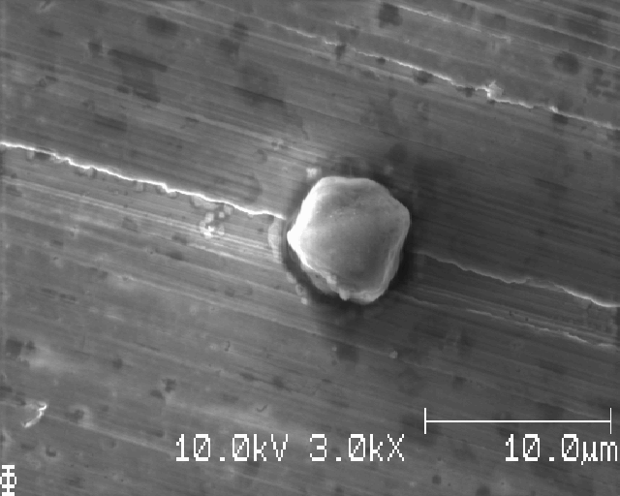
SEM-images
The Lonely Li
Notes:
Olika CA f ̈or T-cell: s ̊ag hur ett prov ser ut opolerat (r ̊akade v ̈anda den), polering kr ̈avs!
S ̊ag f ̈or 0,050 att det var nukleering och mycket tillv ̈axt, f ̈or 0,025 var det snarare nukleering
̈an tillv ̈axt men en del skr ̈ap gjorde det sv ̊art att s ̈aga, f ̈or 0,010 var det i princip inget Li
(f ̈orutom ’The Lonely Li’). OBS! Dessa prover blev lite strul under cellmontering, varf ̈or
m ̈angden Li p ̊a de inte b ̈or tas som r ̈attvis sanning. Mer homogen Li-deposition i T-cell
(tryckfri) j ̈amf ̈ort med knappcell. Tv ̈atten var oregelbunden f ̈or dessa prover

Slide 23
What we learned
Polishing the Cu is necessary
Dirt/salt on the surface obscures everything beneath it → need good washing!
10 second submersion in DME leaves much dirt/salt on surface
1 minute submersion seems appropriate
Notes:
Olika CA f ̈or T-cell: s ̊ag hur ett prov ser ut opolerat (r ̊akade v ̈anda den), polering kr ̈avs!
S ̊ag f ̈or 0,050 att det var nukleering och mycket tillv ̈axt, f ̈or 0,025 var det snarare nukleering
̈an tillv ̈axt men en del skr ̈ap gjorde det sv ̊art att s ̈aga, f ̈or 0,010 var det i princip inget Li
(f ̈orutom ’The Lonely Li’). OBS! Dessa prover blev lite strul under cellmontering, varf ̈or
m ̈angden Li p ̊a de inte b ̈or tas som r ̈attvis sanning. Mer homogen Li-deposition i T-cell
(tryckfri) j ̈amf ̈ort med knappcell. Tv ̈atten var oregelbunden f ̈or dessa prover

Slide 24
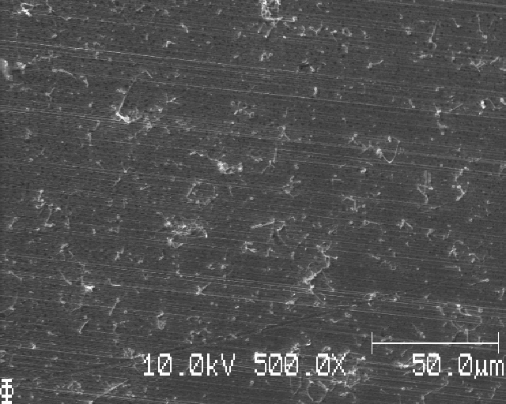
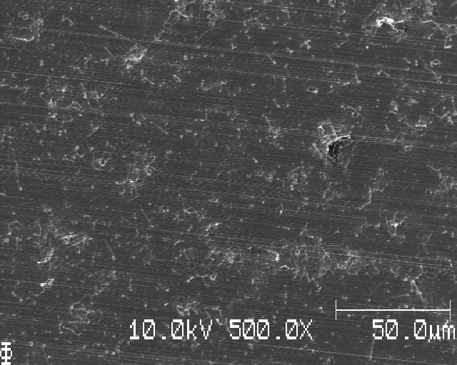
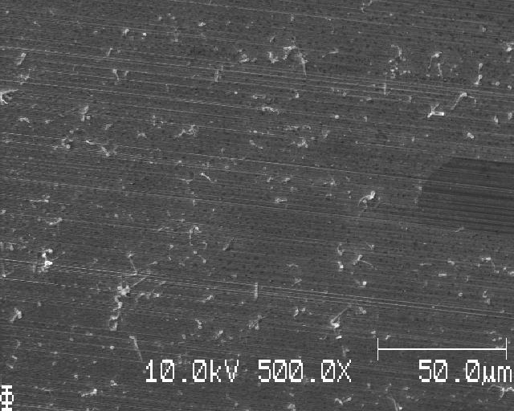
SEM-images
Reproducability, homogenity:
Notes:
Reproducerbarhet: tre likadana prover. Tv ̊a av proverna var mycket lika i m ̈angd Li och
morfologi. Ett prov uppvisade riktad Li-deposition l ̈angs poleringslinjer, troligtvis som
f ̈oljd av underm ̊alig polering. CA lika med 0,020 visade nukleering och tillv ̈axt, b ̈or prova
0,005; 0,010 och 0,015 f ̈or att hitta vilket v ̈arde som ̈ar mest l ̈ampligt. Testade Auger:
s ̊ag Li, O och S p ̊a alla m ̈atta punkter. S ̊ag ingen Cu n ̈ar jag kollade p ̊a Li-k ̈arnor. Test: sputtra l ̈att och sen m ̈at igen! Testade 10kV accelerationssp ̈annin och en str ̊alstr ̈om p ̊a
5nA vilket jag anser var en vettig avv ̈agning mellan signal och uppl ̈osning (1nA gav d ̊alig
signal).

Slide 25
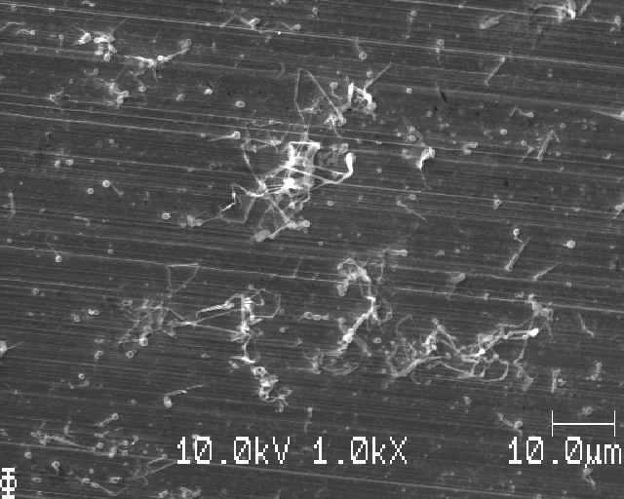
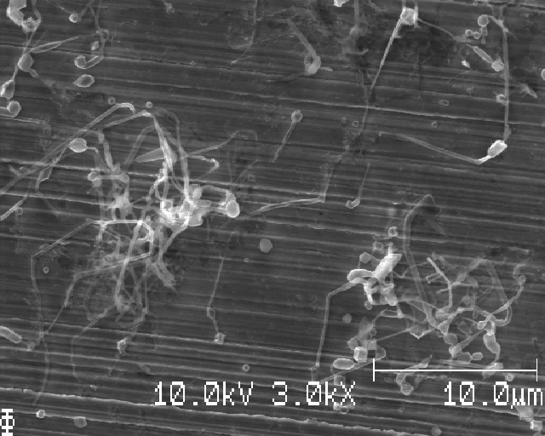
SEM-images
Needle-growth (different places)

Slide 26
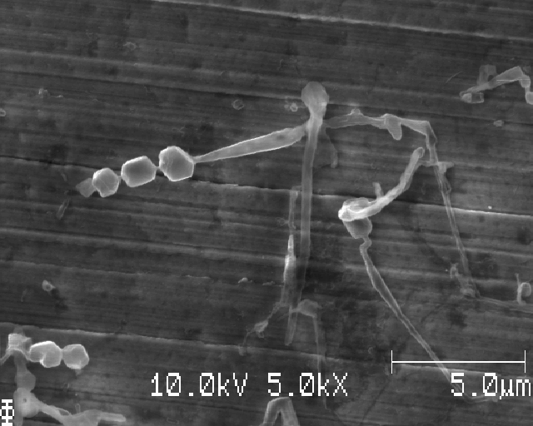
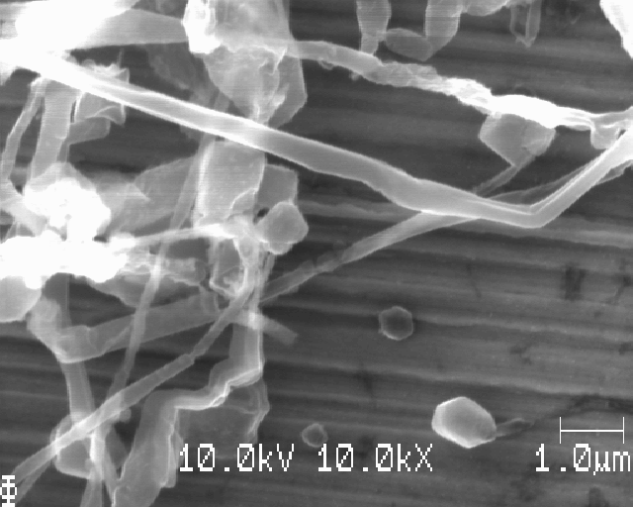
SEM-images
Needle-growth (different places)

Slide 27
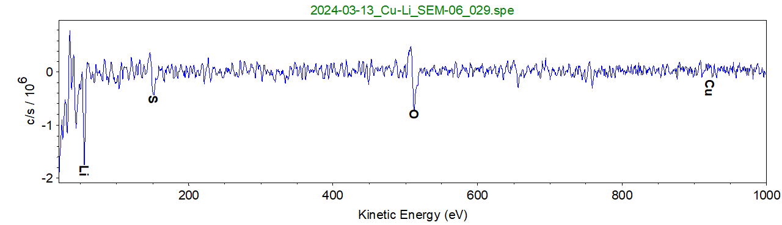
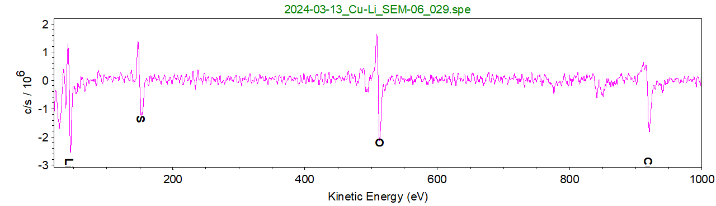
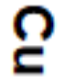
SEM-images: Auger
Evidence for Li?
Li?
Cu
Notes:
Reproducerbarhet: tre likadana prover. Tv ̊a av proverna var mycket lika i m ̈angd Li och
morfologi. Ett prov uppvisade riktad Li-deposition l ̈angs poleringslinjer, troligtvis som
f ̈oljd av underm ̊alig polering. CA lika med 0,020 visade nukleering och tillv ̈axt, b ̈or prova
0,005; 0,010 och 0,015 f ̈or att hitta vilket v ̈arde som ̈ar mest l ̈ampligt. Testade Auger:
s ̊ag Li, O och S p ̊a alla m ̈atta punkter. S ̊ag ingen Cu n ̈ar jag kollade p ̊a Li-k ̈arnor. Test: sputtra l ̈att och sen m ̈at igen! Testade 10kV accelerationssp ̈annin och en str ̊alstr ̈om p ̊a
5nA vilket jag anser var en vettig avv ̈agning mellan signal och uppl ̈osning (1nA gav d ̊alig
signal).

Slide 28
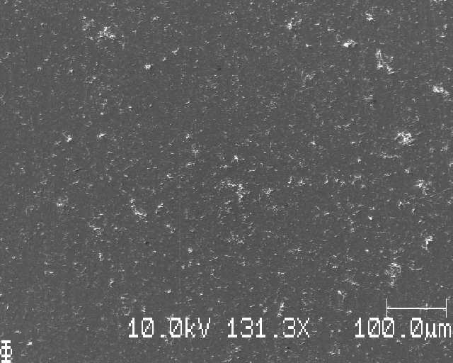
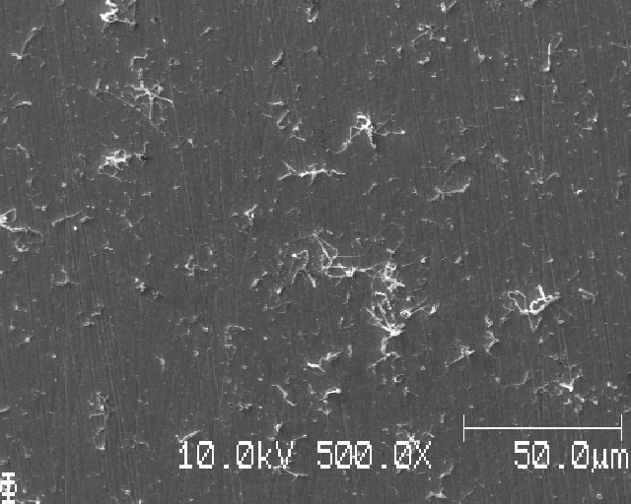
SEM-images
0.020 mAh/cm²:
Notes:
Evenly distributed Li-deposition for these last three samples (AA, AB, AC).
The deposited Li were evenly distributed for all samples, however the Q_A's were high enough for nucleation and growth.
Need less than Q_A = 0.010 mAh/cm2 to see only nucleation.
The polishing to P4000 seems to not be a problem.

Slide 29
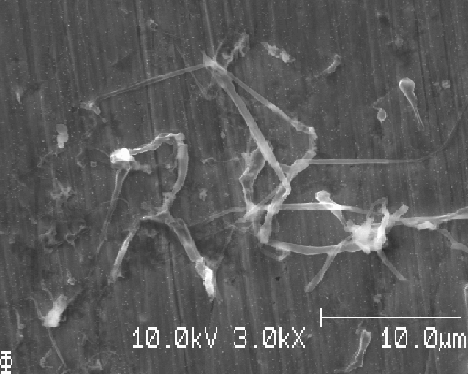
SEM-images
0.020 mAh/cm²:

Slide 30
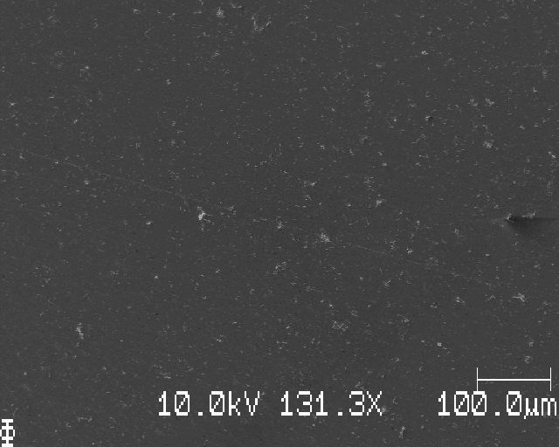
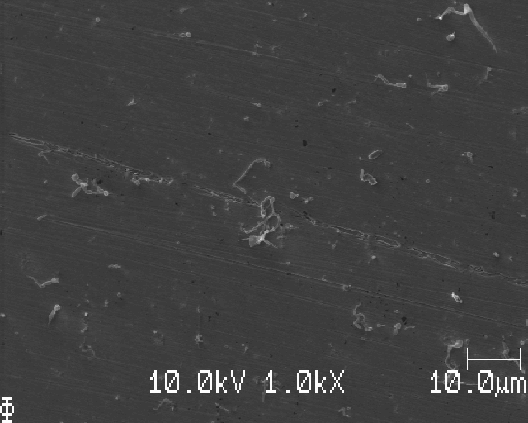
SEM-images
0.015 mAh/cm²:

Slide 31
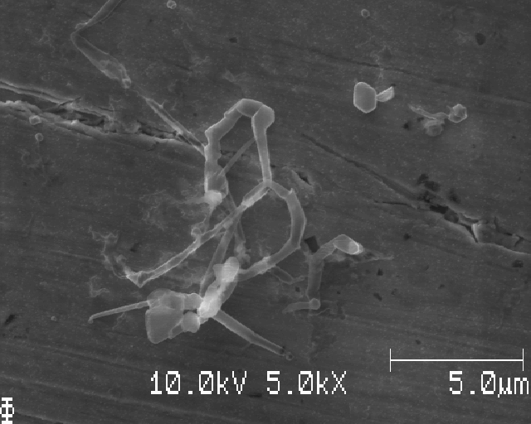
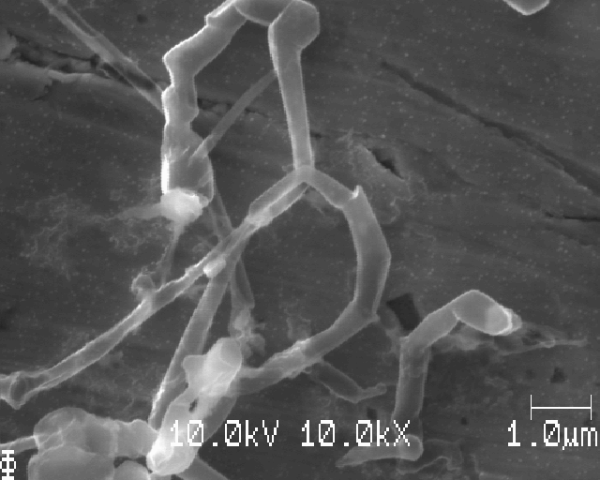
SEM-images
0.015 mAh/cm²:

Slide 32


SEM-images
0.015 mAh/cm²:

Slide 33


SEM-images
0.010 mAh/cm²:

Slide 34
What we learned
T-cells gives much more homogenous Li-nucleation than coin cells
The reproducibility seems fine
Auger can see Li and the absence of Cu
Try sputtering to get rid of constant Li-signal from SEI
Nucleation and growth for 0.010 mAh/cm²
Very small (~100 nm) Li-nuclei?
Notes:
Reproducerbarhet: tre likadana prover. Tv ̊a av proverna var mycket lika i m ̈angd Li och
morfologi. Ett prov uppvisade riktad Li-deposition l ̈angs poleringslinjer, troligtvis som
f ̈oljd av underm ̊alig polering. CA lika med 0,020 visade nukleering och tillv ̈axt, b ̈or prova
0,005; 0,010 och 0,015 f ̈or att hitta vilket v ̈arde som ̈ar mest l ̈ampligt. Testade Auger:
s ̊ag Li, O och S p ̊a alla m ̈atta punkter. S ̊ag ingen Cu n ̈ar jag kollade p ̊a Li-k ̈arnor. Test: sputtra l ̈att och sen m ̈at igen! Testade 10kV accelerationssp ̈annin och en str ̊alstr ̈om p ̊a
5nA vilket jag anser var en vettig avv ̈agning mellan signal och uppl ̈osning (1nA gav d ̊alig
signal).

Slide 35

Data analysis test

Slide 36
Experimental process: what we’ve learned
Prepare materials
Assemble cell
Cycle
Disassemble cell and wash electrode
Measure in SEM
Data analysis of SEM-images
Notes:
investigate nucleation for:
substrates, I and Q/A
other work have researched nucleation for different current densities and areal capacities for THE SAME substrate
this work aims to produce SEM images of nucleation for different substrates

Slide 37
Experimental process: what we’ve learned
Prepare materials
Polishing is necessary, current method seems fine
Assemble cell
Cycle
Disassemble cell and wash electrode
Measure in SEM
Data analysis of SEM-images
Notes:
investigate nucleation for:
substrates, I and Q/A
other work have researched nucleation for different current densities and areal capacities for THE SAME substrate
this work aims to produce SEM images of nucleation for different substrates

Slide 38
Experimental process: what we’ve learned
Prepare materials
Polishing is necessary, current method seems fine
Assemble cell
T-cell gives homogenous Li-deposition, coin cell do not
Cycle
Disassemble cell and wash electrode
Measure in SEM
Data analysis of SEM-images
Notes:
investigate nucleation for:
substrates, I and Q/A
other work have researched nucleation for different current densities and areal capacities for THE SAME substrate
this work aims to produce SEM images of nucleation for different substrates

Slide 39
Experimental process: what we’ve learned
Prepare materials
Polishing is necessary, current method seems fine
Assemble cell
T-cell gives homogenous Li-deposition, coin cell do not
Cycle
SEI-formation protocol determined
< 0.010 mAh/cm² for nucleation without growth in T-cell
Disassemble cell and wash electrode
Measure in SEM
Data analysis of SEM-images
Notes:
investigate nucleation for:
substrates, I and Q/A
other work have researched nucleation for different current densities and areal capacities for THE SAME substrate
this work aims to produce SEM images of nucleation for different substrates

Slide 40
Experimental process: what we’ve learned
Prepare materials
Polishing is necessary, current method seems fine
Assemble cell
T-cell gives homogenous Li-deposition, coin cell do not
Cycle
SEI-formation protocol determined
< 0.010 mAh/cm² for nucleation without growth in T-cell
Disassemble cell and wash electrode
Washing is necessary, submersion for 1 minute in DME seems fine
Measure in SEM
Data analysis of SEM-images
Notes:
investigate nucleation for:
substrates, I and Q/A
other work have researched nucleation for different current densities and areal capacities for THE SAME substrate
this work aims to produce SEM images of nucleation for different substrates

Slide 41
Experimental process: what we’ve learned
Prepare materials
Polishing is necessary, current method seems fine
Assemble cell
T-cell gives homogenous Li-deposition, coin cell do not
Cycle
SEI-formation protocol determined
< 0.010 mAh/cm² for nucleation without growth in T-cell
Disassemble cell and wash electrode
Washing is necessary, submersion for 1 minute in DME seems fine
Measure in SEM
10kV 3nA gives reasonable signal-to-noise and resolution
Auger might be able to separate Li from Cu with some sputtering
Data analysis of SEM-images
Notes:
investigate nucleation for:
substrates, I and Q/A
other work have researched nucleation for different current densities and areal capacities for THE SAME substrate
this work aims to produce SEM images of nucleation for different substrates

Slide 42
Experimental process: what we’ve learned
Prepare materials
Polishing is necessary, current method seems fine
Assemble cell
T-cell gives homogenous Li-deposition, coin cell do not
Cycle
SEI-formation protocol determined
< 0.010 mAh/cm² for nucleation without growth in T-cell
Disassemble cell and wash electrode
Washing is necessary, submersion for 1 minute in DME seems fine
Measure in SEM
10kV 3nA gives reasonable signal-to-noise and resolution
Auger might be able to separate Li from Cu with some sputtering
Data analysis of SEM-images
Preliminary tests done (to be continued)
Notes:
investigate nucleation for:
substrates, I and Q/A
other work have researched nucleation for different current densities and areal capacities for THE SAME substrate
this work aims to produce SEM images of nucleation for different substrates

Slide 43
Thank you!
Comments or questions?

Slide 44



Slide 45


Slide 46



Slide 47


Slide 48


Slide 49


Slide 50



Slide 51



Slide 52


Notes:
Very short time (left), long time (right)

Slide 53


SEM-images
0.0014 mAh/cm² (left) and 0.0028 mAh/cm² (right), no Li
Notes:
L ̊ag CA: V ̈aldigt lite Li (0,0014 och 0.0028 mAh cm−2), f ̈or l ̊ag CA f ̈or att se Li-k ̈arno

Slide 54


SEM-images
Notes:
Dark parts: electrolyte (applied and not washed)
Light parts: no electrolyte applied
⇒ Washing is necessary
10 seconds – saw black spots
1 minute – (almost) no black spots

Slide 55



Slide 56




